Slide 1
Frictional Manipulation with Pushing, Pulling, Sliding
ME319 - JunEn Low, Tony Chen

Slide 2
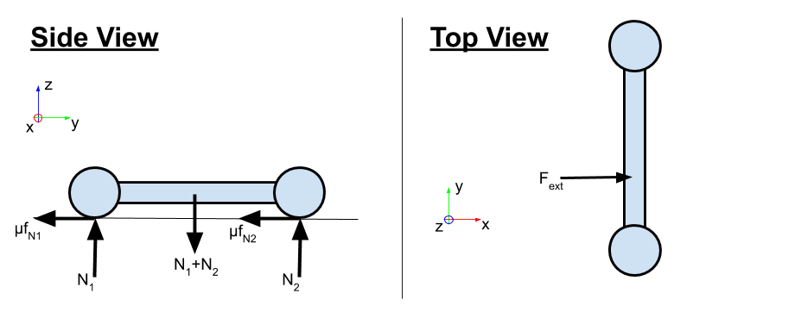
Motivating Question
Given a board with 2 “feet” (contact patches): How does it behave when you push on it? Can you predict when it will start sliding?
Can you predict the instantaneous motion direction (twist)?

Slide 3
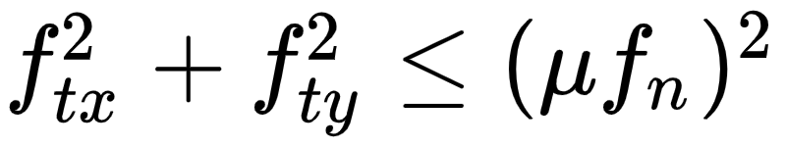
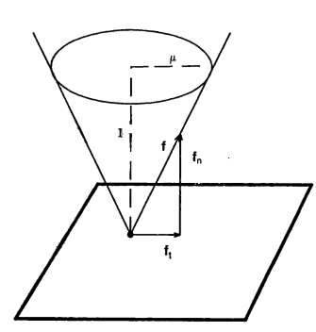
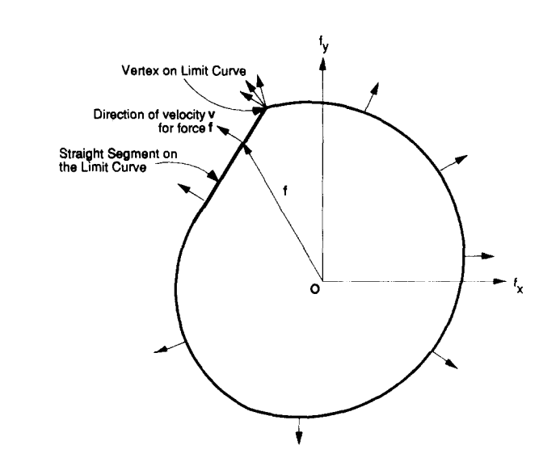
Friction Limit Surface Fundamentals
Goyal and Ruina: Consider a generalization (“weak form”) of the Coulomb friction law: Instead of saying there is a friction cone with the law:
which describes a circle, we say that it is a convex closed shape.
Figs from: Mason, Mechanics and Planning of Manipulator Pushing Operations (1986), Goyal and Ruina, Planar Sliding with Dry Friction, Part 1 (1990)
Notes:
Fig from Goyal and Ruina paper, Planar Sliding with Dry Friction, Part 1 (1990)

Slide 4
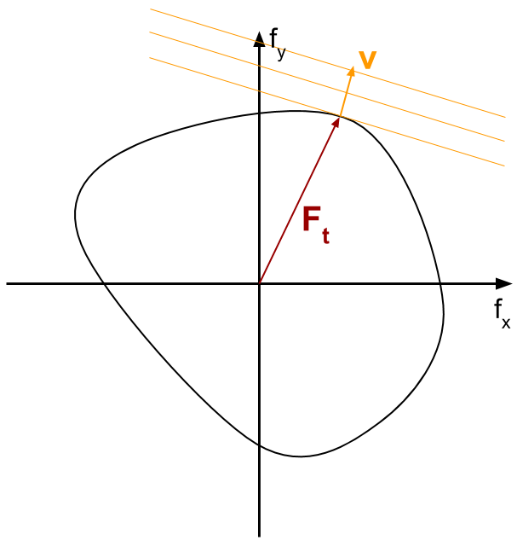
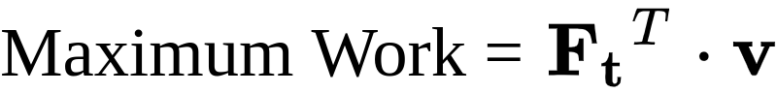
Friction Limit Surface Fundamentals
Any force vector F_{t} = [f_{tx} f_{ty}] inside this shape will not slip.
As the force vector intersects the shape, it slips.
The instantaneous direction of motion is given by the normal vector (i.e. the [v_{x} v_{y}] direction is parallel to the unit normal to the curve where [f_{x} f_{y}] intersects it)
This can also be expressed as a maximum work inequality:
Notes:
Consider any direction, v. Take lines perpendicular to v and find where they intersect the limit surface. The maximum possible work (dissipated power) will be if F goes from the origin to the same point (maximum possible dot product of F and v). The same idea can be generalized to a convex friction surface in [fx,fy,mz] wrench space; now we take planes perpendicular to v and find when the intersect the surface.

Slide 5
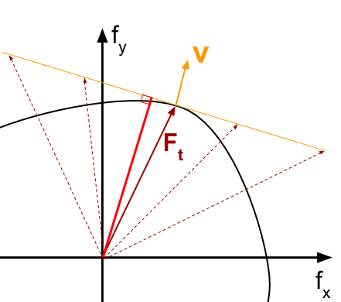
The Maximum Work Inequality
Why Maximum Work?
“is a description of material behavior. The reader is cautioned against trying to relate it to common notions of minimum potential energy or positive entropy production.”
Why is it max at the intersection?
F_{t}^{T} ᐧ v remains the same along the hyperplane defined by the normal vector v
F_{t}^{T} ᐧ v drops as we approach origin
By convexity, the furthest point would thus be the max.
F_{t}^{T} ᐧ v
Notes:
Show a closed convex curve in (X,Y) space and [fx,fy] vectors and lines of orientation given by unit vector [vx,vy] and how where they contact the curve, the unit normal is tangent to the line. And also the product [ftx,fty]^t*[vx,vy] gives the maximum work (power) of all possible forces that intersect the curve.
In other words, given a direction [vx,vy], the corresponding slip force is the one on the curve that gives the maximum work.
So what? It means that if you construct a convex friction limit surface in wrench space F = [fx,fy,mz] for an object that slides on a physical surface you can use it to find both when an object will start to slide (when F intersects the limit surface) and in what direction it will move (given by the unit normal to the surface at the intersection).

Slide 6
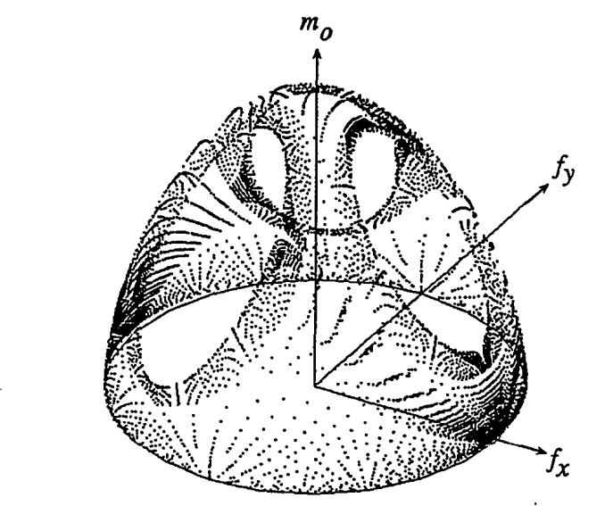
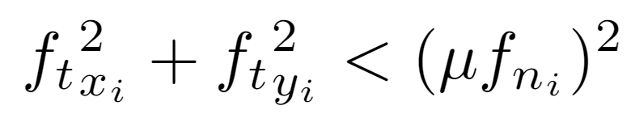
Limit Surface for multiple points
We can extend the point analysis to a collection of points or a body sliding in the plane in SE(2).
We can sum the forces and moments from each point.
Or we can create the LS as the Minkowski sum of the LS from each point.
The LS of any pressure distribution is the Minkowski sum of the LS of its constituent components.
Notes:
Fig from S-H Lee thesis (1990) showing LS for 3 points. The facets correspond to when COR is directly beneath one of the points, so for that point there are multiple solutions: ftx_i^2 + fty_i^2 < (mu fn_i)^2
A thing about friction limit surfaces is that they are often not intuitive because the force is independent of the magnitude of velocity.
LS for multiple points or contact patches = Minkowski sum of the LS for each of the points or patches.

Slide 7
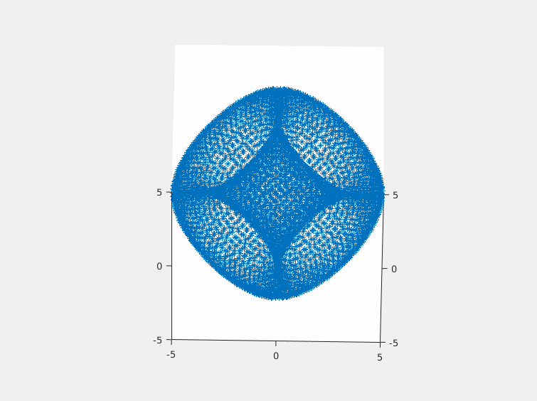
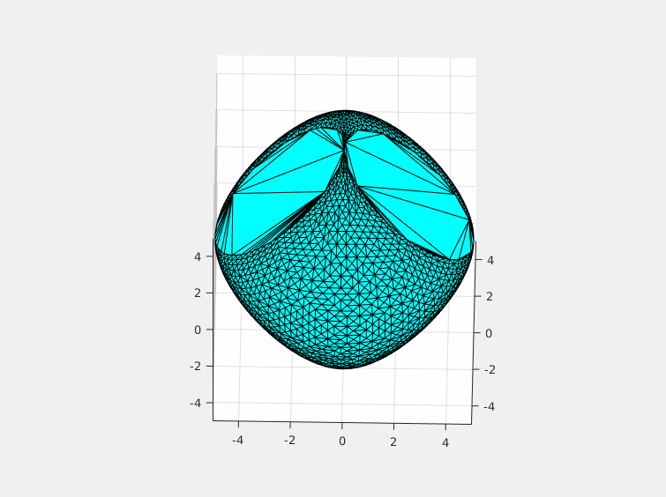
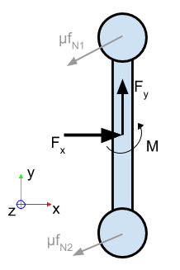
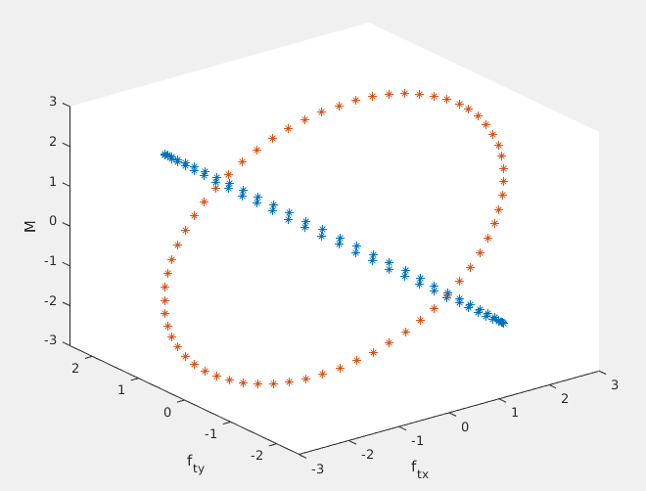
Back to Our Board with 2 Feet
Notes:
Each contact patch results in a friction LS that is a tilted ellipse in wrench space [fx, fy, mz]. The combined LS can be obtained by taking the Minkowski sum of these 2 ellipses, or plotted directly in wrench space. The result is the convex shape at right. Note that it can go both and above the mz=0 plane, depending on whether rotations are clockwise or anticlockwise.

Slide 8
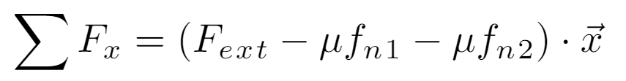
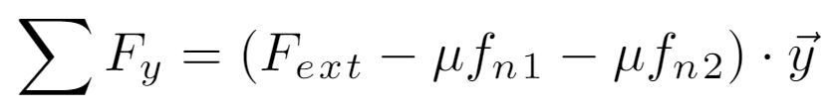
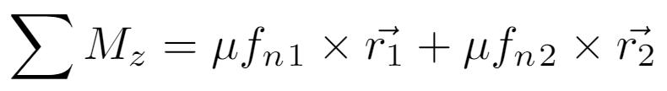
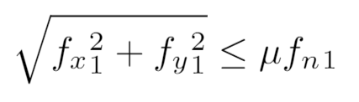
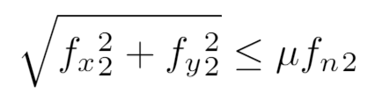
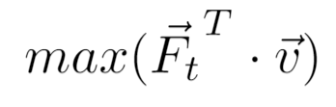
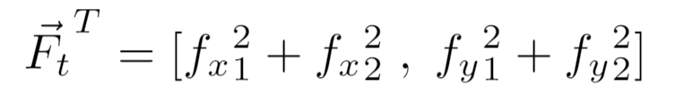
Back to Our Board with 2 Feet, with equations
-
4 unknowns
3 linear equations, 2 non-linear constraints
Based on Maximum Work Inequality, we want to maximize power
Notes:
For some reason the 2020 students computed negative torque (f x r) instead of r x f… It makes no real difference.
Write the equations for the board with 2 feet and see if we can solve them.
Notice that if the COR location is known, we get linear equations. This also works if the COR is underneath any one of a small set of contact points -- it corresponds to “facets” on the LS, as seen in slide 6.

Slide 9
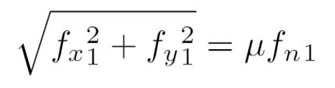
If the object is rotating about one of the contact points
4 unknowns
3 linear equations
1 non-linear equality
1 non-linear constraint
-
Notes:
Write the equations for the board with 2 feet and see if we can solve them.
Notice that if the COR location is known, we get linear equations. This also works if the COR is underneath any one of a small set of contact points -- it corresponds to “facets” on the LS.

Slide 10
If the object is rotating about one of the contact points
4 unknowns
3 linear equations
1 non-linear equality
1 non-linear inequality constraint
-
Notes:
Write the equations for the board with 2 feet and see if we can solve them.
Notice that if the COR location is known, we get linear equations. This also works if the COR is underneath any one of a small set of contact points -- it corresponds to “facets” on the LS.

Slide 11
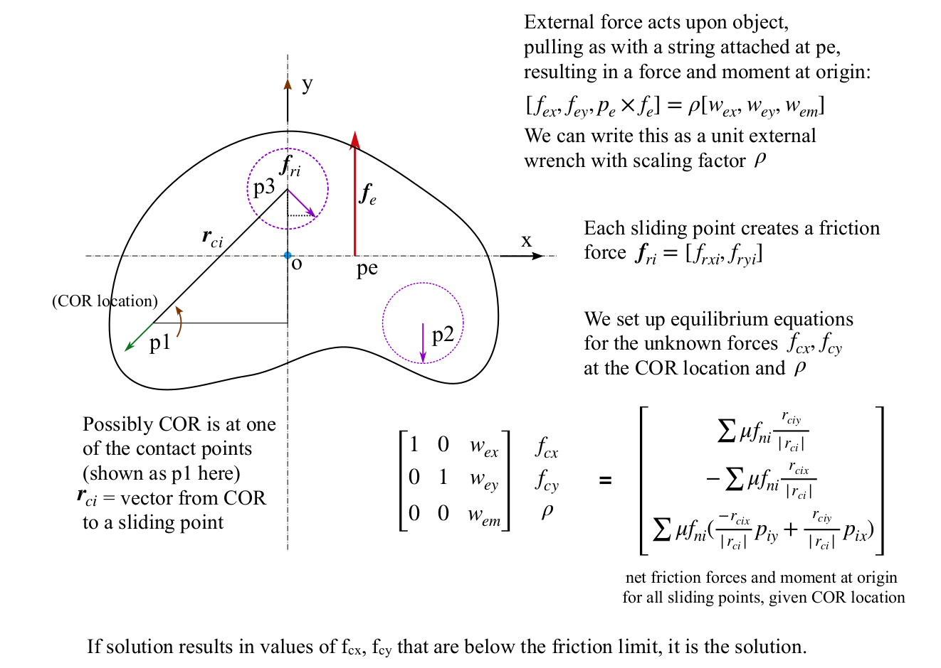
Sakurai (1990) continued
Could it be pivoting about one of the contacts?
If COR is at one of the contact points, we know the friction forces at the other two sliding points exactly.
This gives enough information to solve the problem as a linear set of equations.
If a valid solution is found, our guess was correct.
(Included in LS-ellipsoid.py)
Notes:
We will need to spend awhile on this one. There is a lot to it. Maybe breakout to white board to talk people through the details.

Slide 12
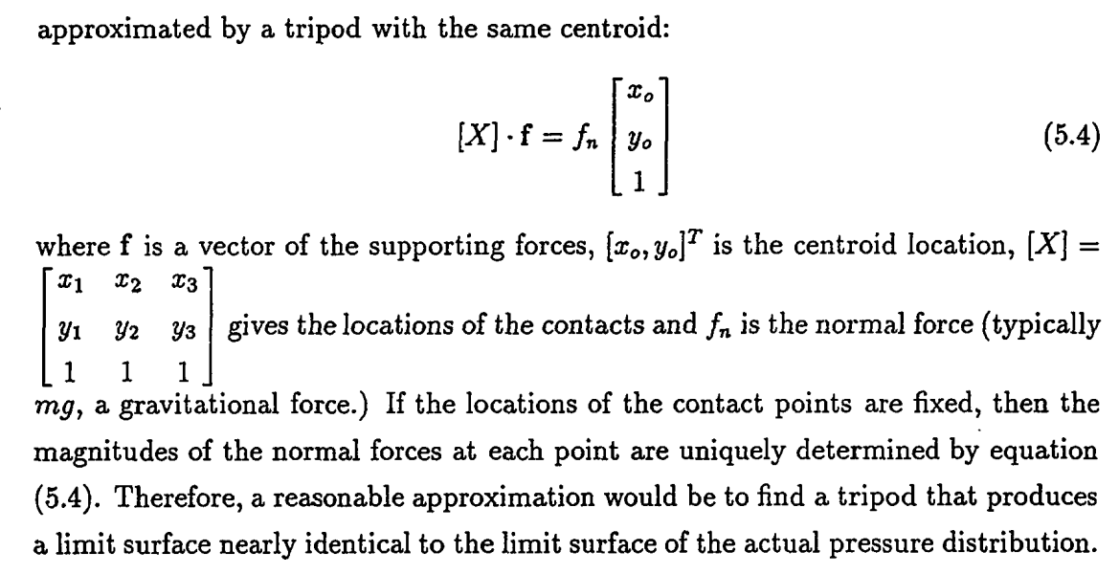
An arbitrary pressure distribution can often be...
M. Mason (1986)
Notes:
Mason noted the above, which is convenient for approximating general pressure distributions.
And as noted in Howe & Cutkosky the actual limit surface is not very sensitive to the details of the pressure distribution.
Therefore, approximating a general pressure distribution with three points may often be good enough for practical purposes.

Slide 13
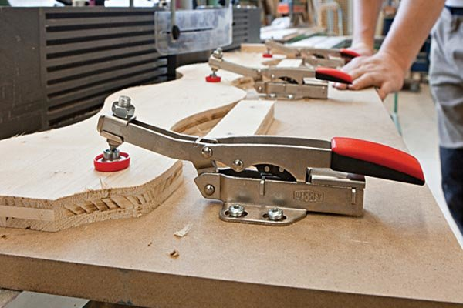
Grasp and fixture planning with friction
Sakurai (MIT) and Lee (Stanford) ~1990 considered the problem of a workpiece held by clamps with friction:
How many clamps needed?
Where to put them?
Maximum external force = ?

Slide 14
Assumptions
Friction forces are dominated by the forces under each clamp.
Clamp contact areas are small enough to approximate by frictional point contacts.
We know where an external wrench [fex, fey, mez]’ is being applied (e.g. by a cutting tool) but we do not know the maximum magnitude that can be resisted without slipping.

Slide 15
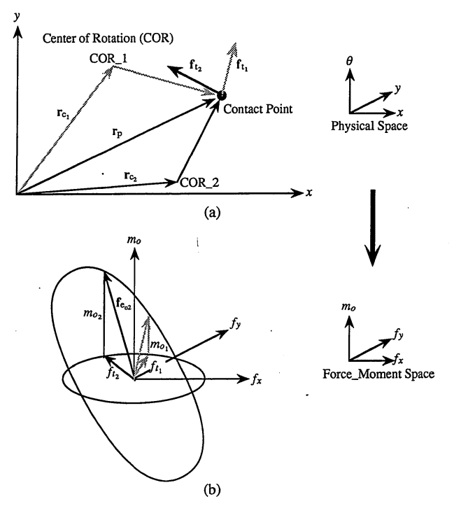
Limit Surface for 1 point
A point sliding on the plane is instantaneously rotating about some CoR.
Its friction force is [f_{tx} f_{ty}] and is antiparallel to its sliding velocity [v_{x} v_{y}].
The corresponding wrench is [f,m_{z}] where f = [f_{tx} f_{ty}] , m_{z} = rxf, and r is from the origin to the point.
Fig from S-H Lee thesis (1990) showing 2 COR locations and their mapping to the Limit Surface (LS), which is an ellipse in SE(2). If we try all possible COR locations, we plot the ellipse. (Note that mz does not depend on COR location.)
Notes:
Fig from S-H Lee thesis (1990) showing 2 COR locations and their mapping to the Limit Surface (LS), which is an ellipse in SE(2). If we try all possible COR locations, we plot the ellipse. (Note that mz does not depend on COR location, only on where the point is with respect to the origin.)

Slide 16
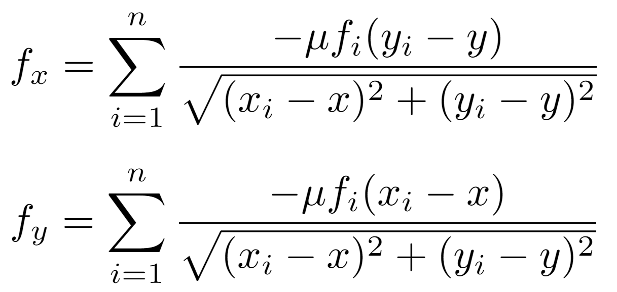
Notes:
Solvable in theory but difficult in practice. We look for a better way.
What are the known and unknown quantities in these two equations? We assume we know where the points are, but we don’t know where the COR is. So we don’t know the quantities like (xi - x) and (yi - y) because we don’t know x and y. We also know the ratio fx/fy (direction of pushing force) but not the magnitude.
But it’s very messy. Conversely, if we did know the COR, then it’s easy to compute fx and fy. Then all the (xi-x) terms are known and for those points that are sliding we know mu*fi.

Slide 17
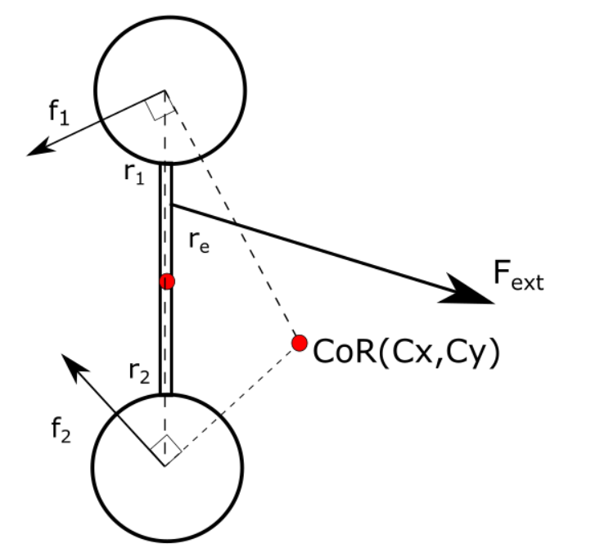
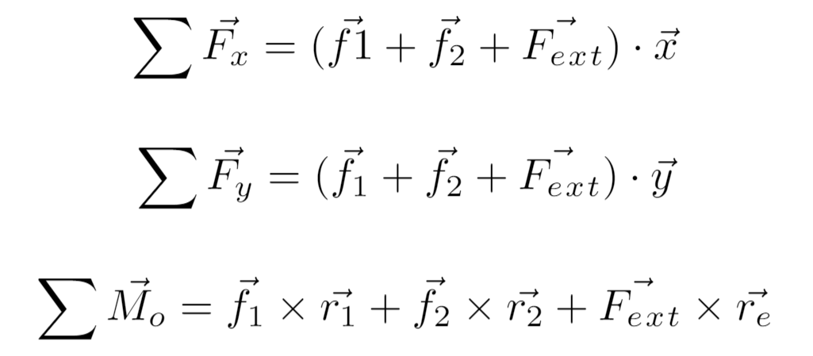
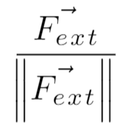
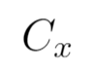
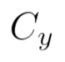
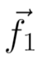
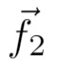
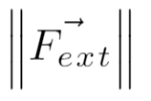
Back again to our same example, now with COR
-
Knowns:
Unknowns:
Notes:
Write the equations for the board with 2 feet and see if we can solve them.
Notice that if the COR location is known, we get linear equations. This also works if the COR is underneath any one of a small set of contact points -- it corresponds to “facets” on the LS.

Slide 18
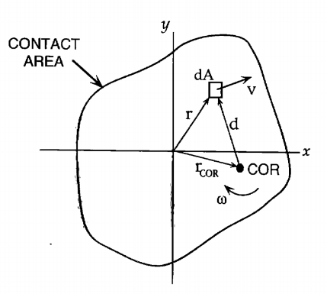
Howe/Cutkosky
Howe and Cutkosky (IJRR 1996) consider arbitrary pressure distributions and calculate the net force and moment for each sliding element.
An ellipsoidal approximation (with facets removed if there are just a few contacts) is a fast and reasonably accurate way to get the force and sliding direction.

Slide 19
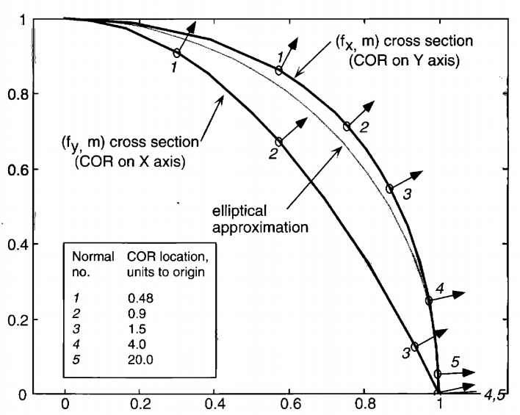
For many pressure distributions, an approximating ellipsoid is reasonably accurate, especially if we put the origin at the center of pressure and if the pressure distribution is not very asymmetric.
The normal to the ellipsoid is easy to compute and gives the sliding direction.
m/m_{max}
Example for a long skinny rectangle (approaching the 2 point case - which one could also use).
f_{t}/f_{tmax}
Notes:
Two assumptions: pressure distribution is more or less symmetric and we put origin at center of pressure.
Then normal of the epllisoid can be calcuated, and it gives the sliding direction per max work inequality

Slide 20
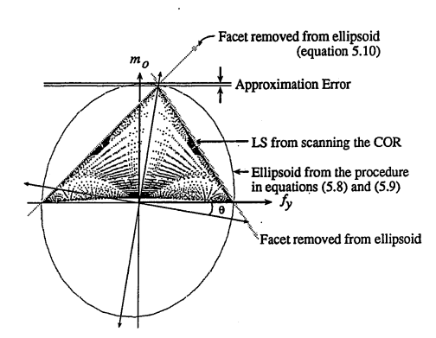
Example from S-H Lee on accuracy of ellipsoid
If the pressure distribution is not relatively symmetric about origin, you can create a tilted ellipsoid that has its long axis terminate at m_max, which occurs if COR is at origin.
Then remove facets if COR could be at one of a few support points.

Slide 21
Exercise Questions
Q1: Using the file SakuraiFrictionProblem.py, see if you can reproduce the results in the example problem in pages 90-100 of H. Sakurai’s MIT PhD thesis. (You will need to fill in some missing blanks in the script.)
Answer questions on the accuracy of the approach.

Slide 22
Exercise Questions
Q 2: Use the script LS-ellipsoid.py to solve the same Sakurai example using the Howe/Cutkosky/Lee ellipsoidal approximation to the friction limit surface. This script is essentially complete, so it’s just a matter of understanding it as you step through it.
Answer questions on the accuracy of the approach.

Slide 23
Sakurai (1990) continued
Could it be pivoting about one of the contacts?
If COR is at one of the contact points, we know the friction forces at the other two sliding points exactly.
In that case, the only unknowns are the tangential force components at the pivoting point: [fcx, fcy]
These must be below friction limit if actually pivoting at this point
Notes:
We will need to spend awhile on this one. There is a lot to it. Maybe breakout to white board to talk people through the details.

Slide 24
Sakurai (1990) continued
Could it be pivoting about one of the contacts?
If COR is at one of the contact points, we know the friction forces at the other two sliding points exactly.
This gives enough information to solve the problem as a linear set of equations.
If a valid solution is found, our guess was correct.
(Included in LS-ellipsoid.py)
Notes:
We will need to spend awhile on this one. There is a lot to it. Maybe breakout to white board to talk people through the details.

Slide 25

Exercise Questions
Q3: A FlyCroTug* has attached a gripper to one leg of a divan and is attempting to drag it (see illustration and diagram with dimensions & data).
3.1 Use the Maximum Work method (adapt from Q1) to solve for the instantaneous divan motion and required tugging force.
3.2 Use the approximating LS Ellipsoid (adapt from Q2) to solve for the instantaneous sofa motion and required tugging force.
*Estrada, M. A., Mintchev, S., Christensen, D. L., Cutkosky, M. R., & Floreano, D. (2018). Forceful manipulation with micro air vehicles. Science Robotics, 3(23), eaau6903.

